Slide 1
AI and CFD

Slide 2
General Taxonomy
AI & CFD
Flow Modeling
Flow Control
Turbulence Closure
Direct Numerical Simulations
Flow Feature Extraction/ROMs
Optimization

Slide 3
Flow Modeling – Turbulence Closure
The large scale of turbulent behavior has been a long-standing problem in fluid dynamics
Machine learning approaches have been applied to RANS and LES simulations
Predicting Reynolds stresses
Improving subgrid scale models
CFDNet loosely fits in this category
Resolving Bulk Flow with CFD
Modeling smaller scale turbulence with AI
Turbulence Closure

Slide 4
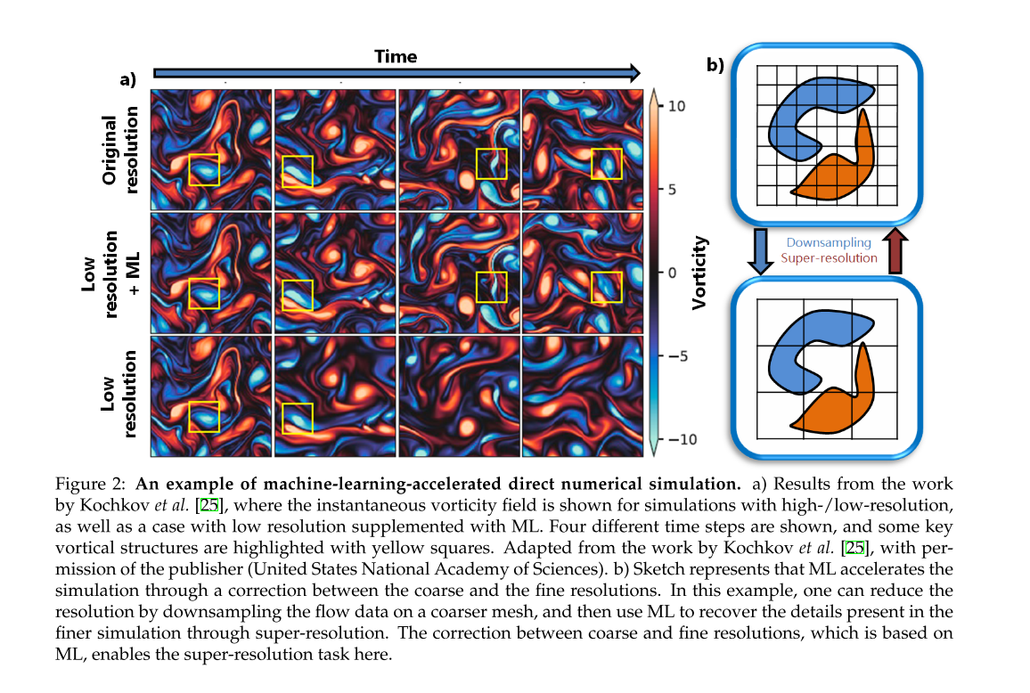
Flow Modeling – DNS/Superresolution
Direct numerical simulations (DNS) are prohibitively expensive
AI applied to this field can be split into two subsets:
Speed up CFD codes by using AI to predict important terms (E.g. Poisson equation or spatial derivatives)
Correct under-resolved DNS simulations with AI models
Vinuesa et al. (2022).

Slide 5
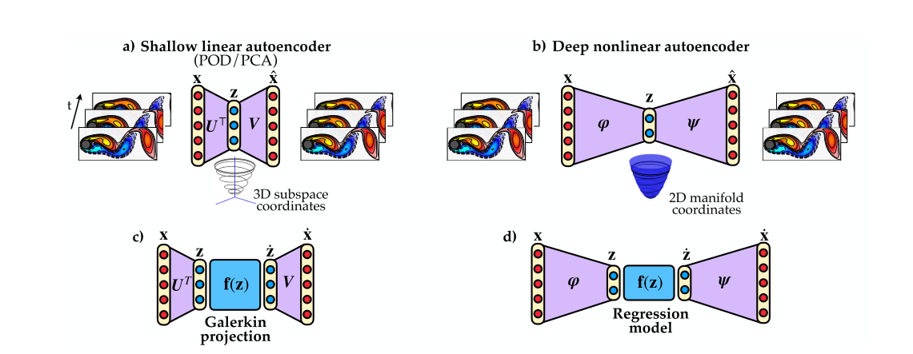
Flow Modeling – Feature Extraction/ROMs
Feature extraction is a common tool in fluid dynamics that tries to pull the most important or dominant flow features from a fluid system
“Old-school” technique is Principle Orthogonal Decomposition (POD)
AI systems, like autoencoders, have now been applied to identify these dominant patterns
Commonly, extracted features will be used to build a reduced-order model (ROM)
Reduced order models are simplified equations or representations of specific fluid systems
AI has been used recently where extracted features are used as input variables
Vinuesa et al. (2022).

Slide 6
Flow Control and Optimization
Control
Optimization
Flow control is broadly the deliberate changing of a fluidic system through actuation and sensor measurement
PID controllers are an excellent example
AI and ML has been applied to replace or augment existing control systems
Aerodynamics like control surfaces are a popular example
Optimization is broadly the parametric study of minimizing or maximizing a desired behavior
The optimization of airfoil shape is an excellent example
AI and ML techniques have a long history of utilization in fluid dynamic optimization studies and still present emerging possibilities
Genetic algorithms and evolutionary strategies are commonly used techniques

Slide 7
Familiarity and Difficulty
AI & CFD
Flow Modeling
Flow Control
Turbulence Closure
Direct Numerical Simulations
Flow Feature Extraction/ROMs
Optimization
Computational physics and theoretical fluid dynamics
Engineering disciplines
Difficult given current expertise
Tractable

Slide 8
Thoughts for Research Projects
Domain Knowledge
Machine Learning
CFD
Research Projects
Focusing on domain problems and applying CFD and AI where possible
Avoid developing “solutions looking for a problem”
Potential Domain Topics?
Coronary artery disease/FFR
Bioreactors
Medical devices

